Slide 1
SPARK

Slide 2
CPU
Parallelization
Core
Thread
Vcpu
SLOT

Slide 3
Scaling
Vertical Scaling
Horizontal Scaling

Slide 4
Spark
Runs Everywhere
Unified platform
In memory-cluster computing framework

Slide 5
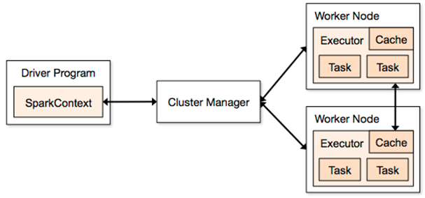

Slide 6
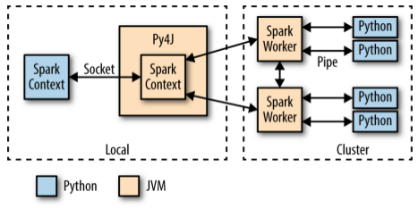

Slide 7
Driver Program
Spark Context
Cluster manager
Worker Nodes
Executors (JVM)
Task / Slots

Slide 8
User Session
Spark Context → RDD
Spark Session
------------------
Spark Context
SQL context
Hive Context
Streaming Context

Slide 9
Lazy evaluation
Transformation
Narrow Transformation
Wide Transformation

Slide 10
Shuffles
Joins
Group By key
Reduce by key
Re-partition

Slide 11
Actions
Take
Top
Collect
Max
Min
Stats

Slide 12
Persisting / Caching
GC
Disk spill/slow

Slide 13
Joins
Safe joins
Sort merge
Both files are large
Shared Variables

Slide 14
Shared Variables
Broadcasting → Show a read only data from the smaller file to larger file
Accumulators → Implement counters

Slide 15
RDD vs DF VS Dataset(only for Scala & Java)
RDD → Low level API
=====
Distributed collection
Immutable
Fault tolerant
Lazy evaluations
Scala, Java, R, Python
Unstructured data
Disadvantage
Doesn’t infer schema, optimization of code is manual

Slide 16
DF
Distributed Collection of Row objects
Optimization → Catalyst Optimizer (Tungsten)
Hive compatibility
Java, Scala, Python, R
Infer schema, it gives structure of the data
Compile time safety

Slide 17
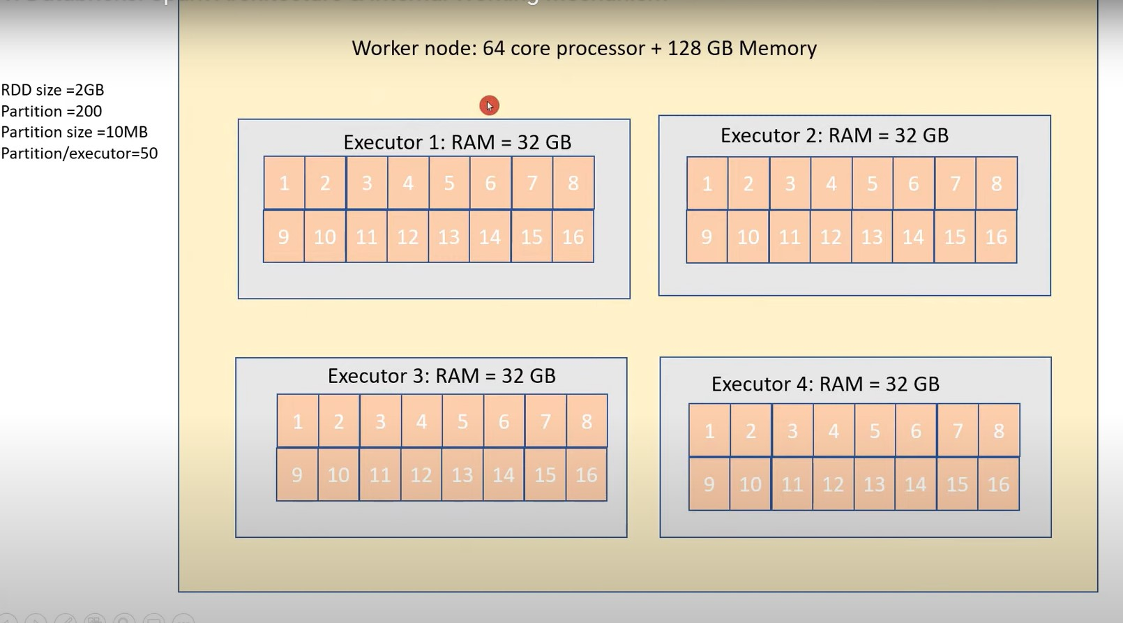

Slide 18
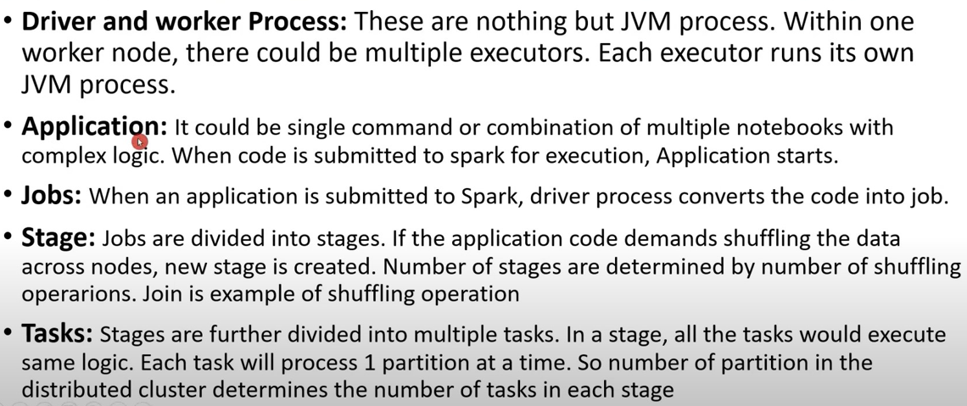

Slide 19
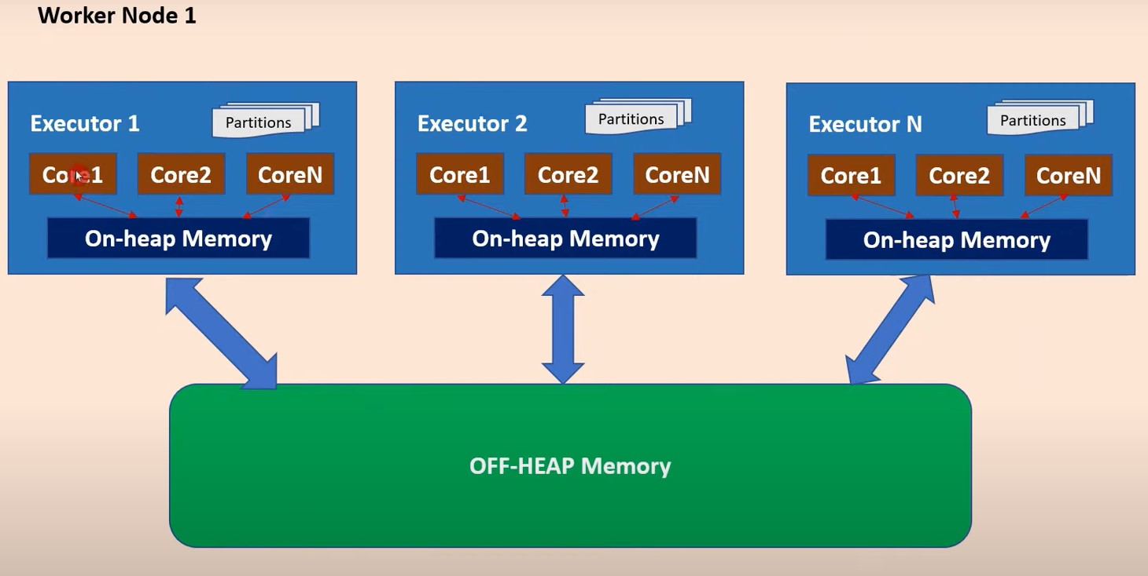

Slide 20
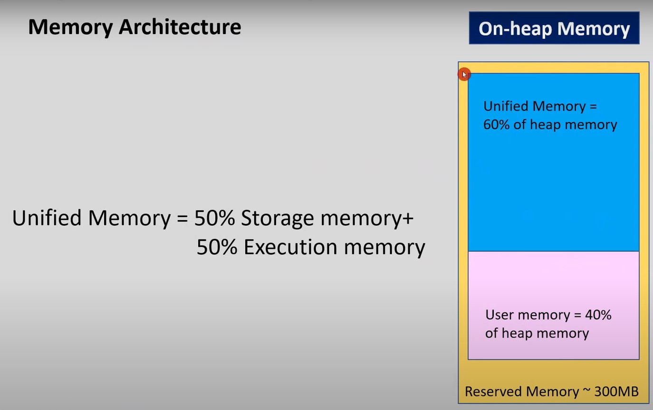

Slide 21
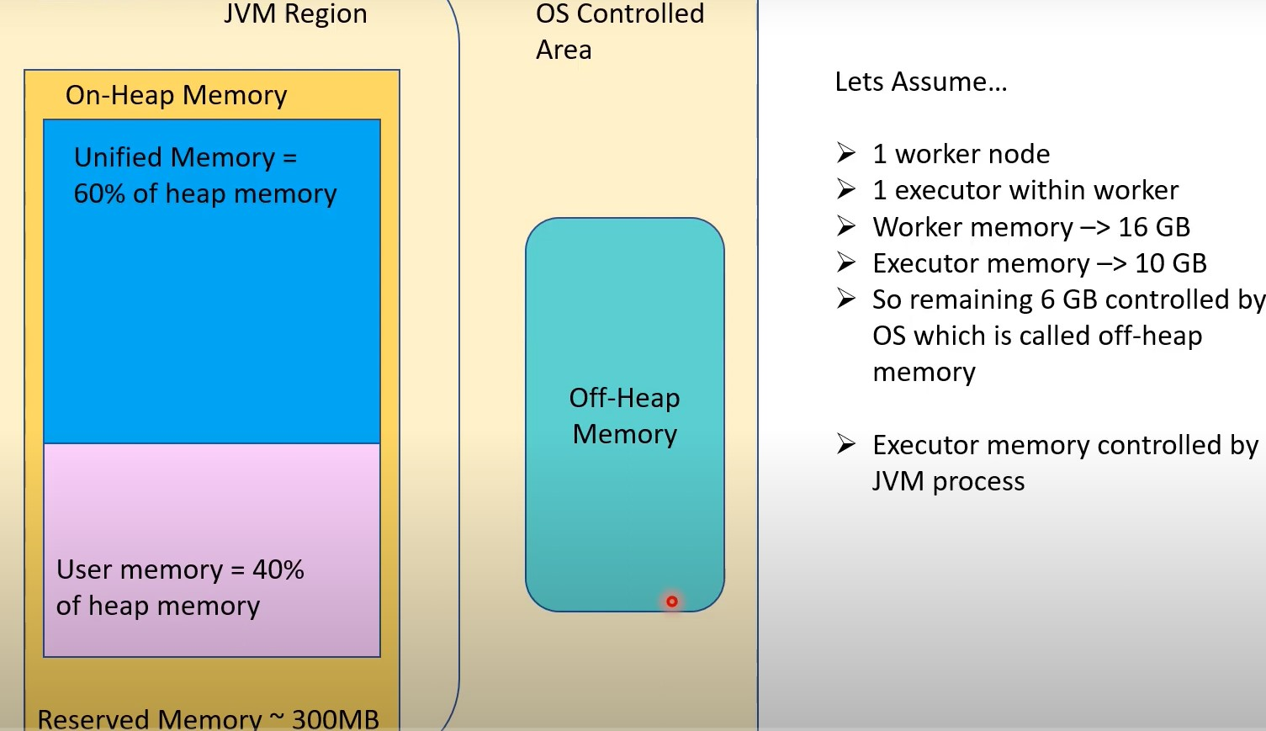

Slide 22
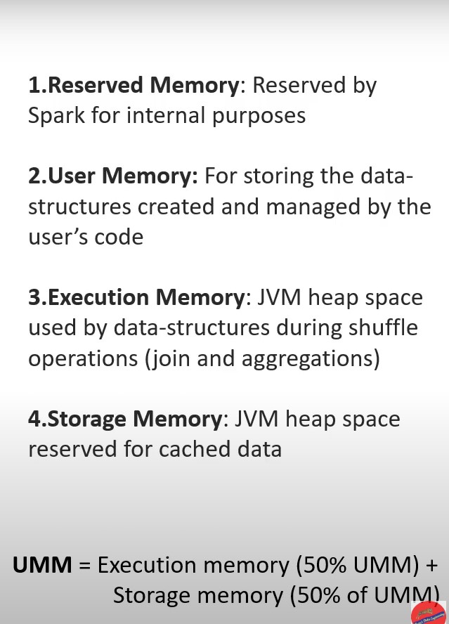

Slide 23
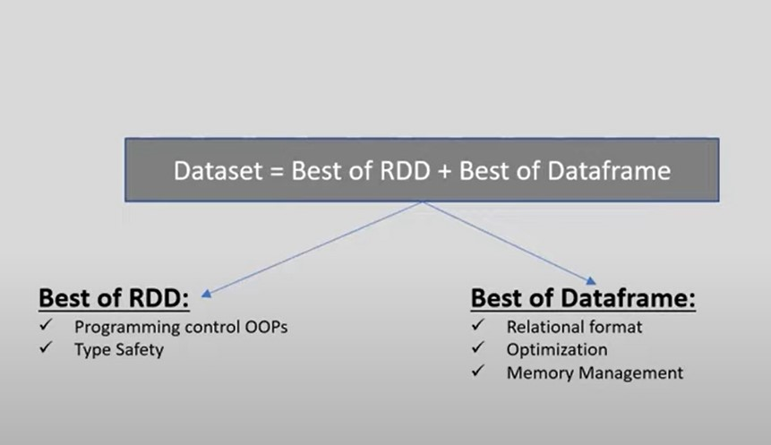

Slide 24
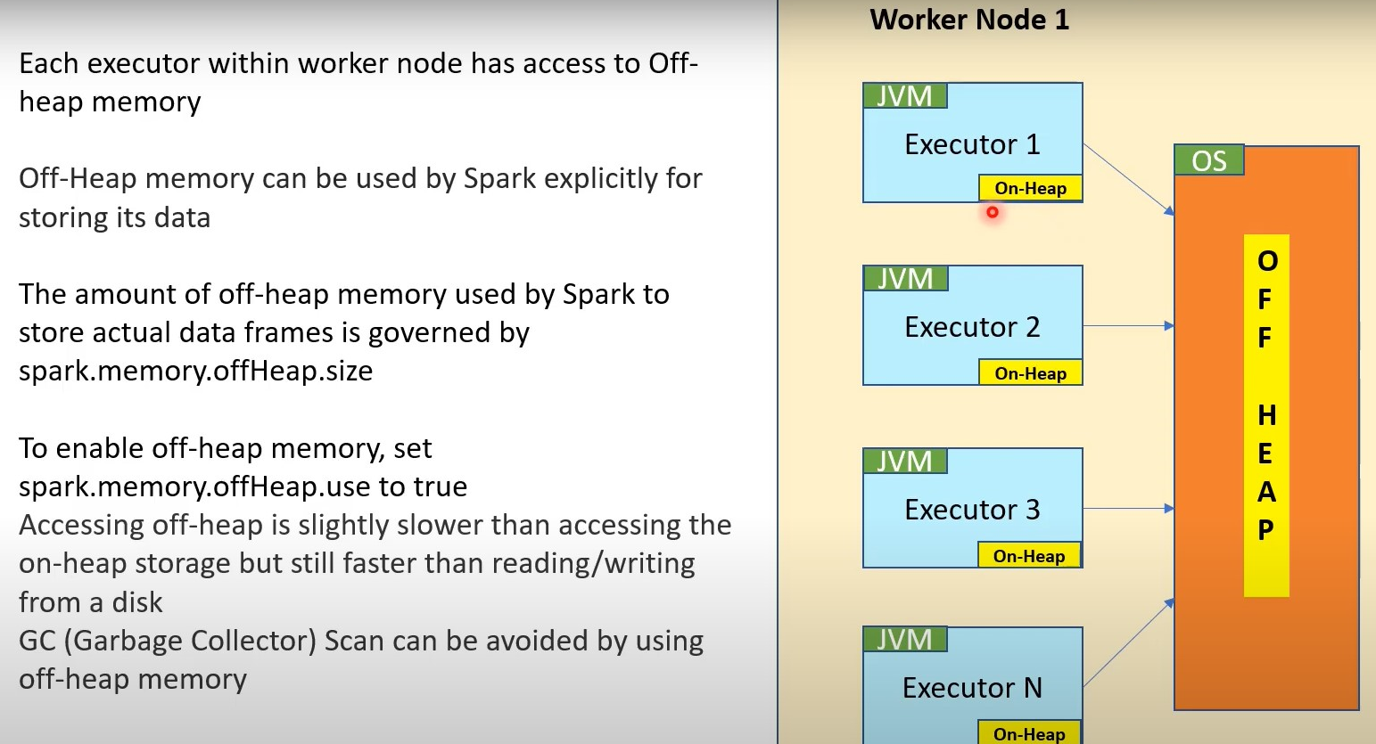

Slide 25
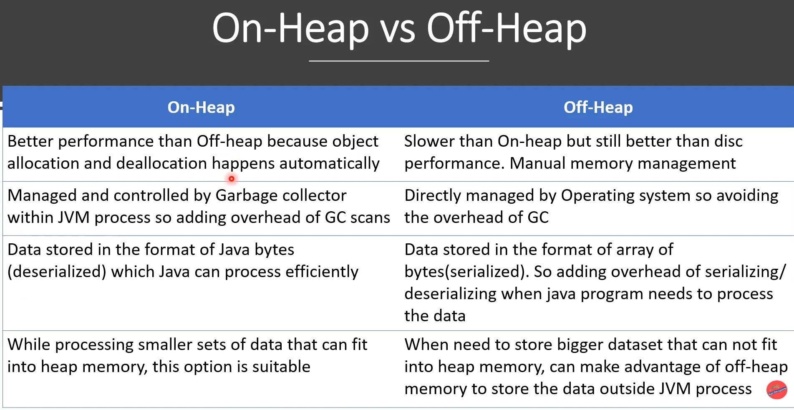

Slide 26
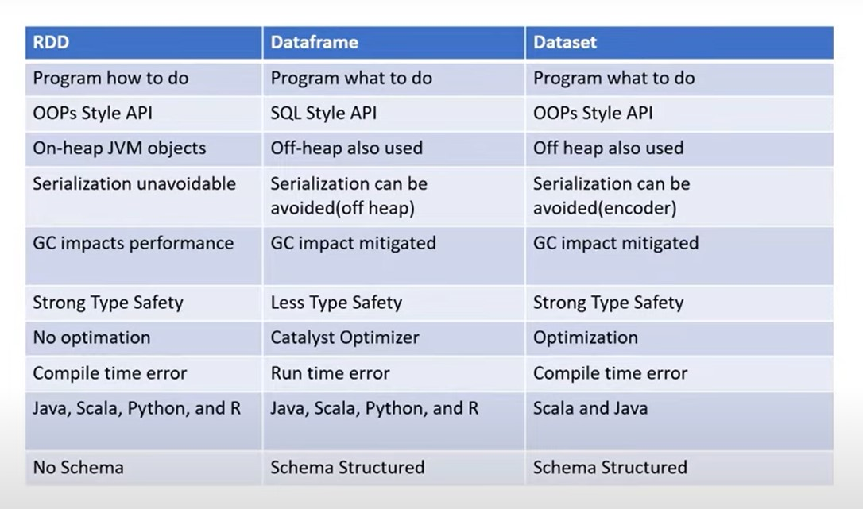

Slide 27
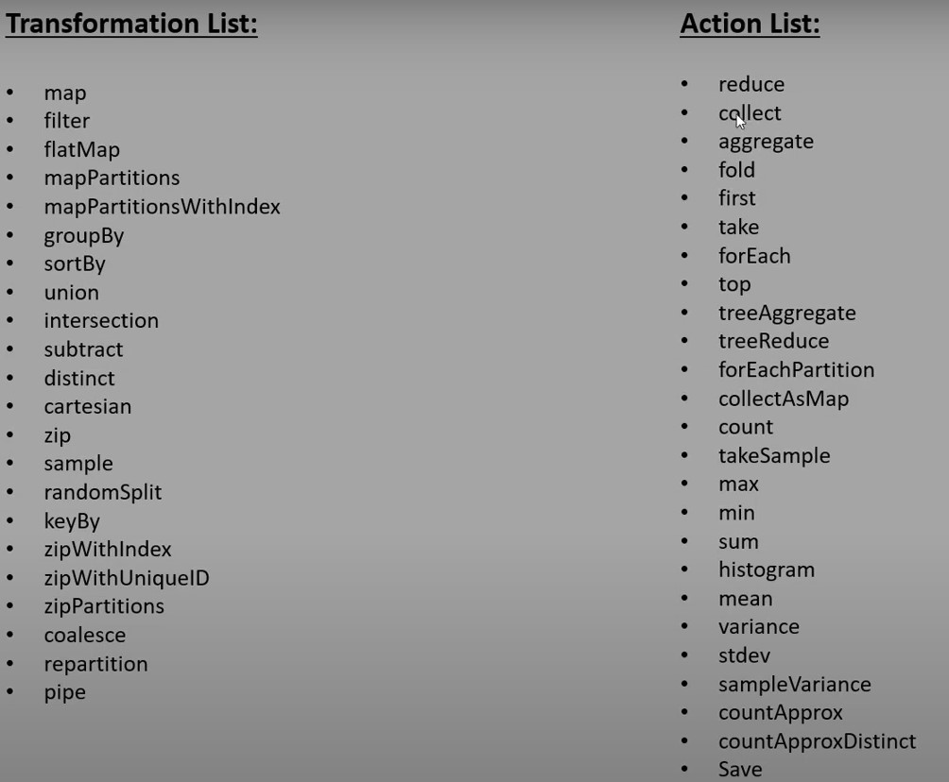

Slide 28
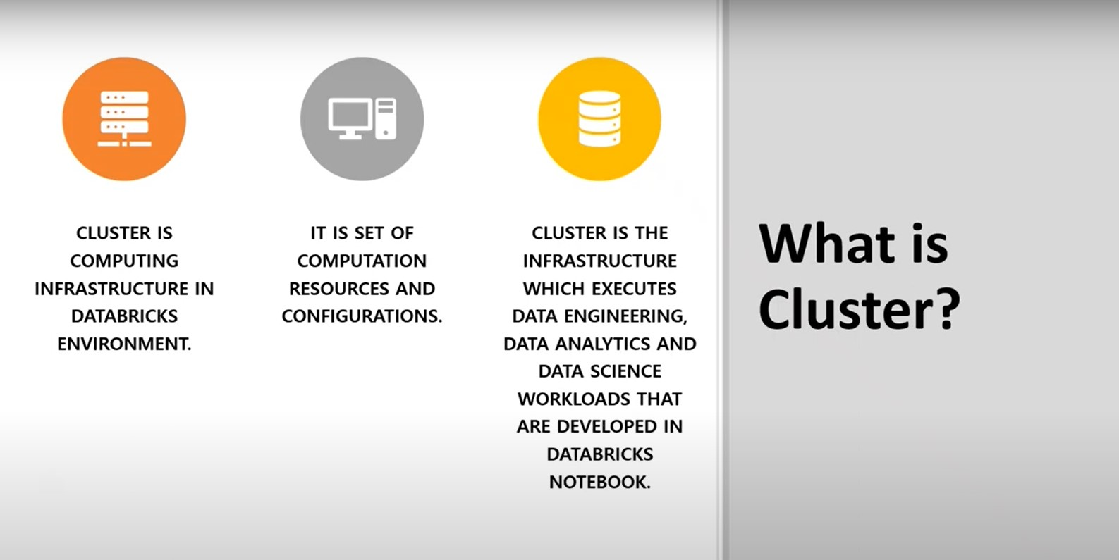

Slide 29
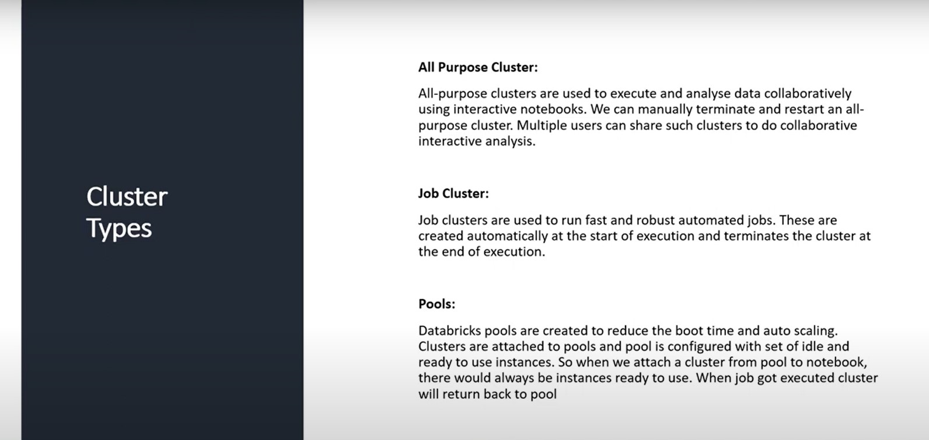

Slide 30
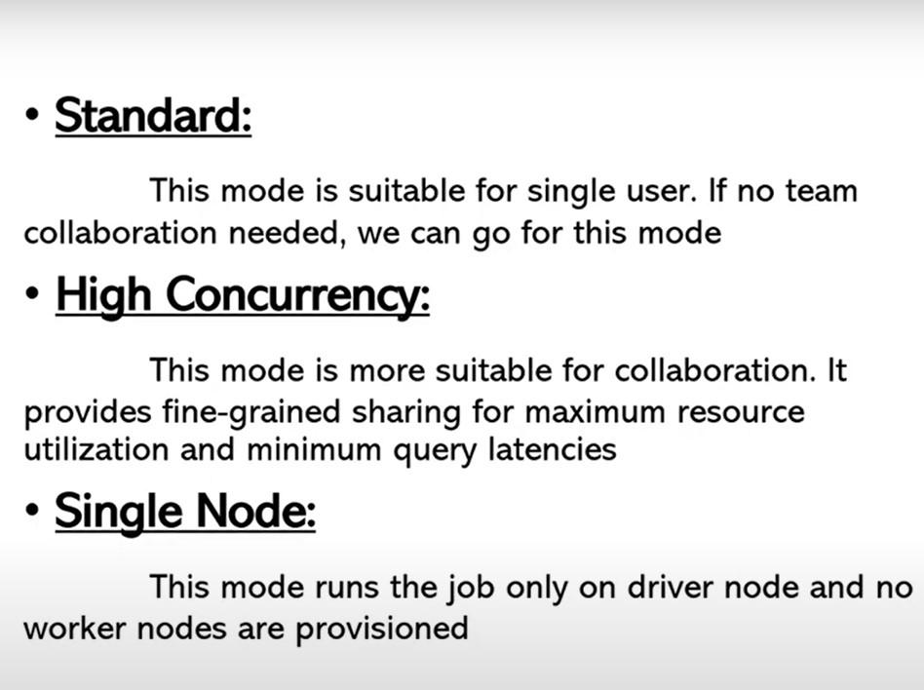

Slide 31
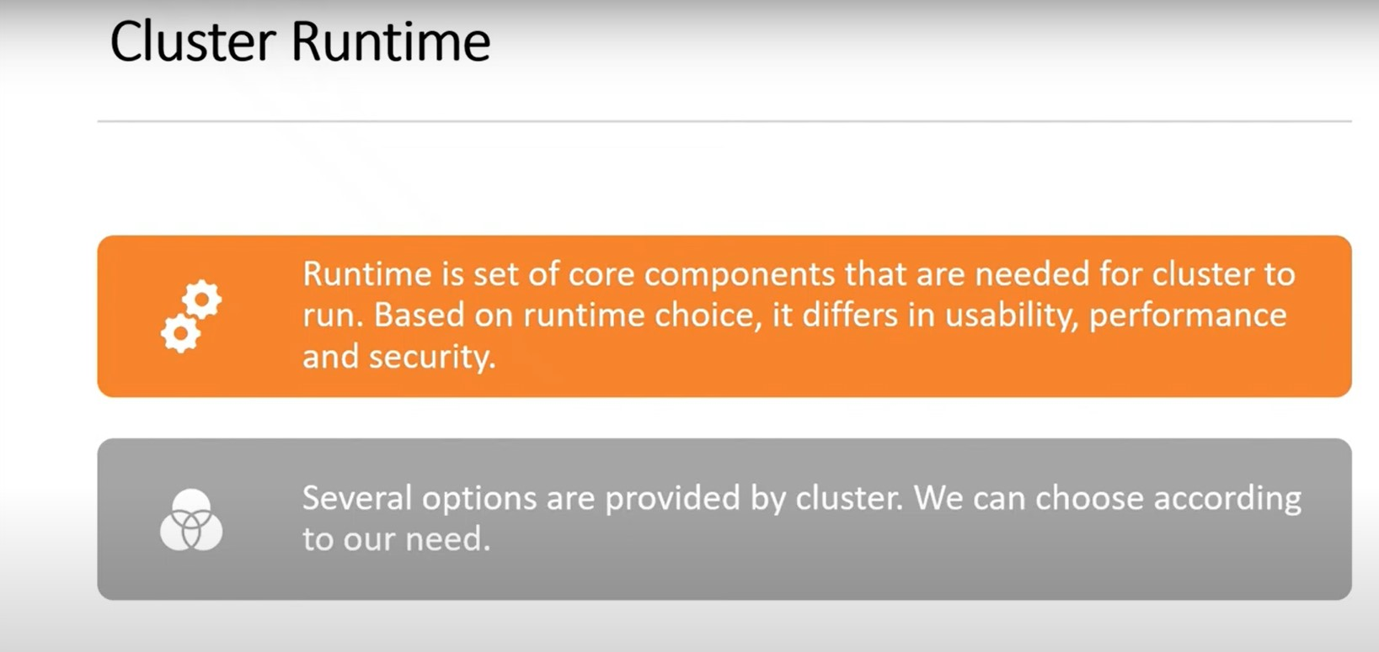

Slide 32
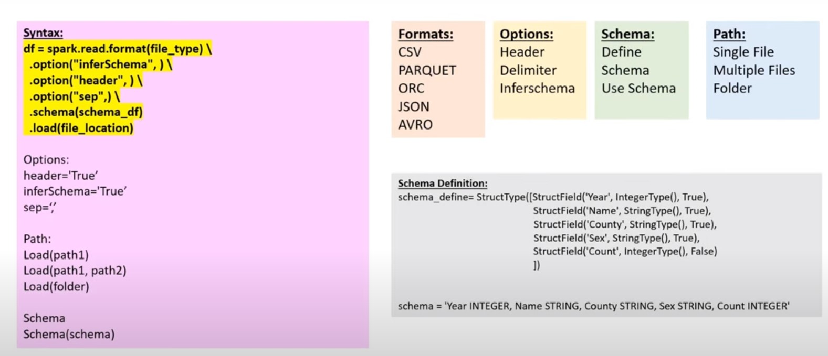

Slide 33
Filter conditions
Single & multiple
Startswith
Endswith
Contains
Like
Null values
isin

Slide 34
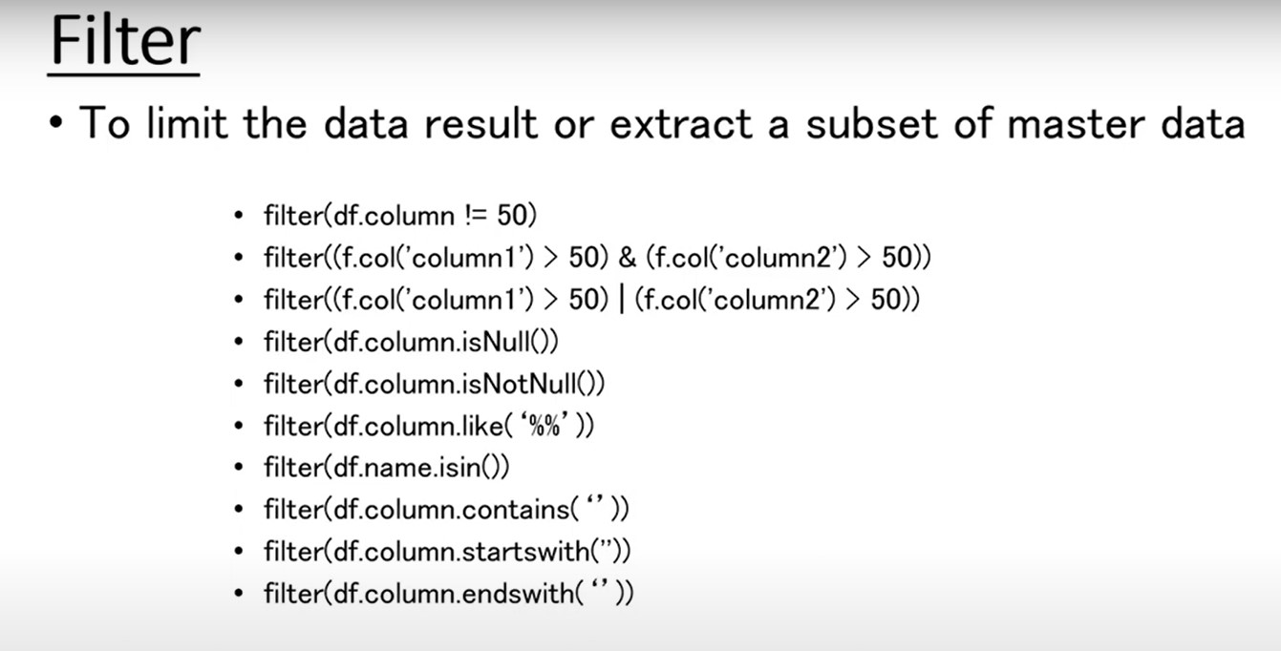

Slide 35
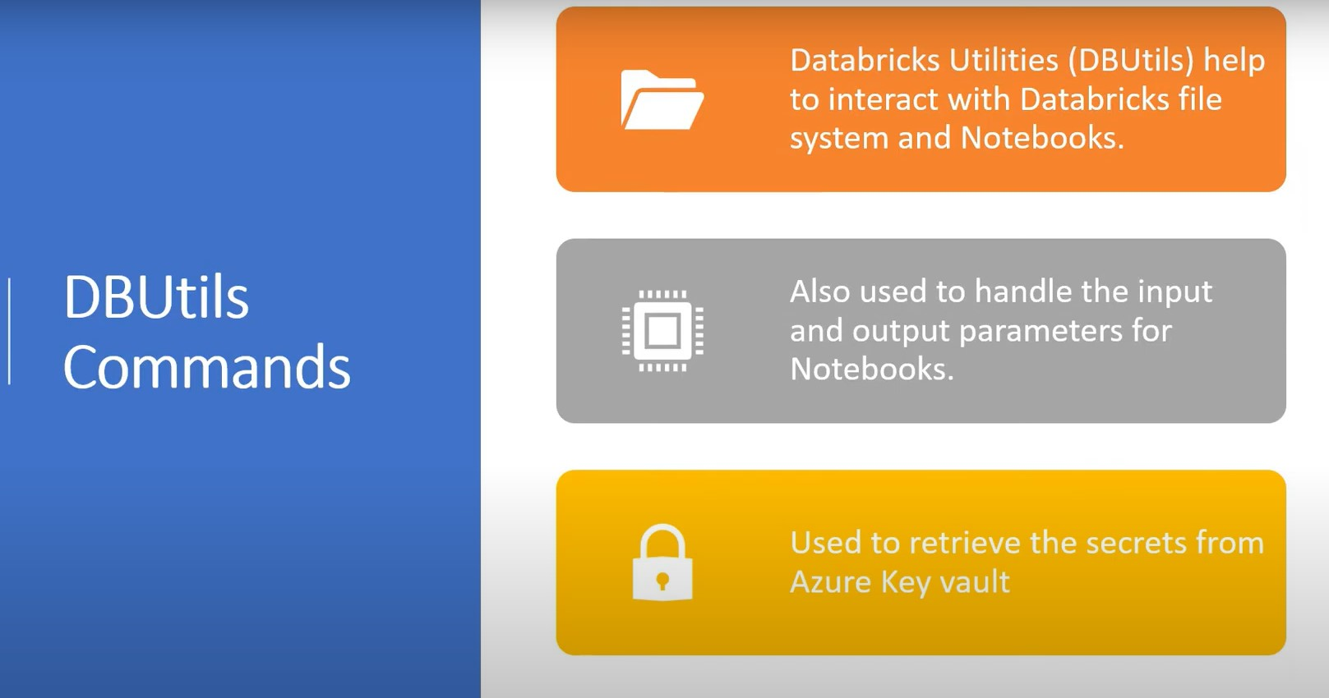
DB utility commands

Slide 36
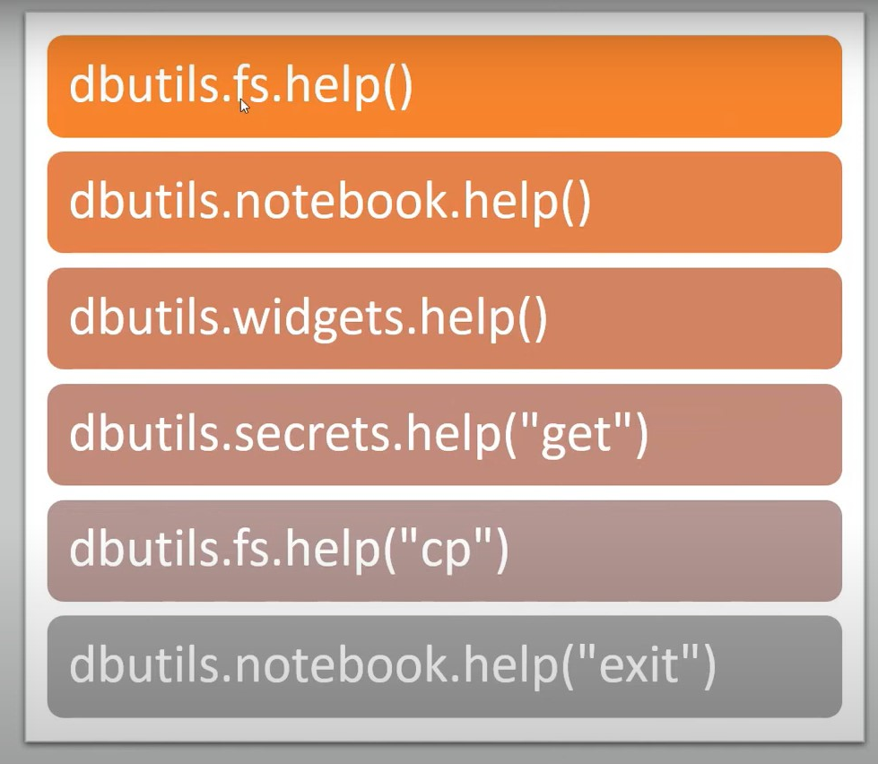
HELP commands

Slide 37
dbutils.fs.help()
dbutils.notebook.help()
dbutils.widgets.help()
dbutils.secretes.help()

Slide 38
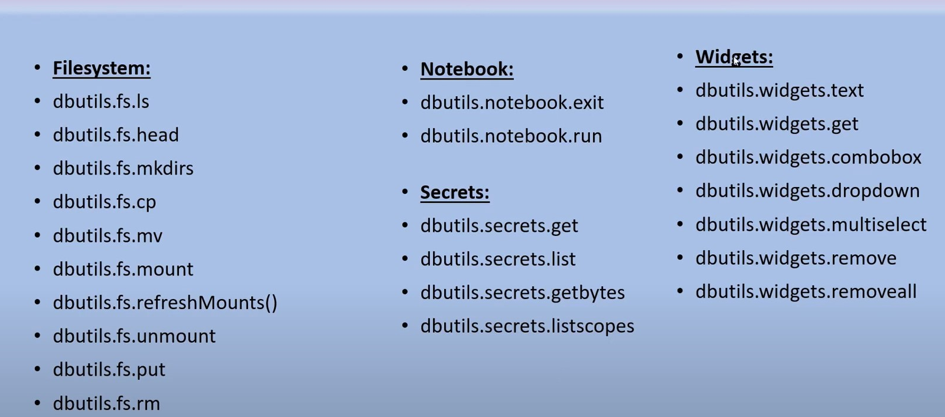

Slide 39
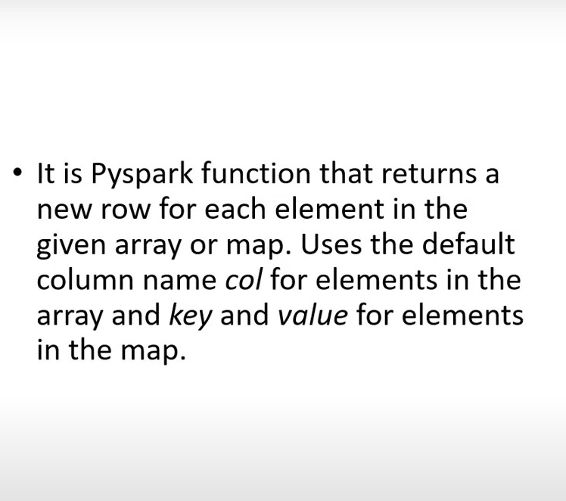
Explode

Slide 40
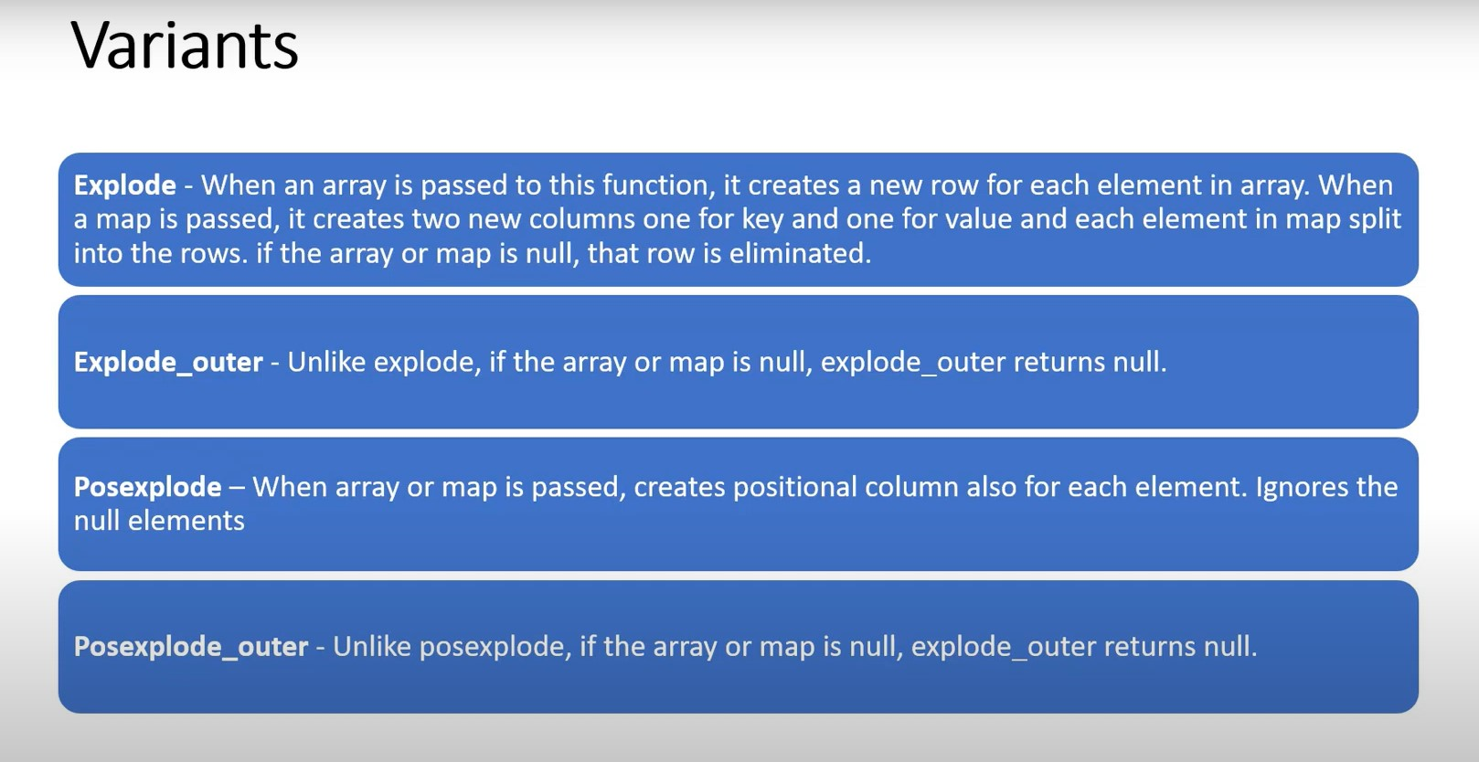

Slide 41
Case Expressions
When
Otherwise

Slide 42
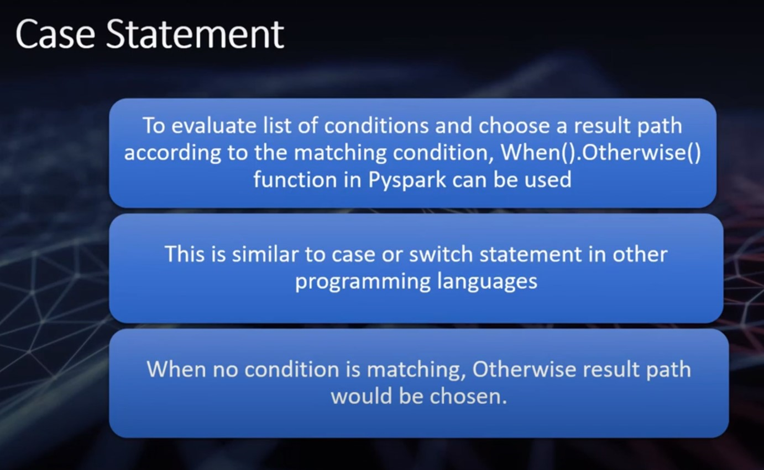

Slide 43
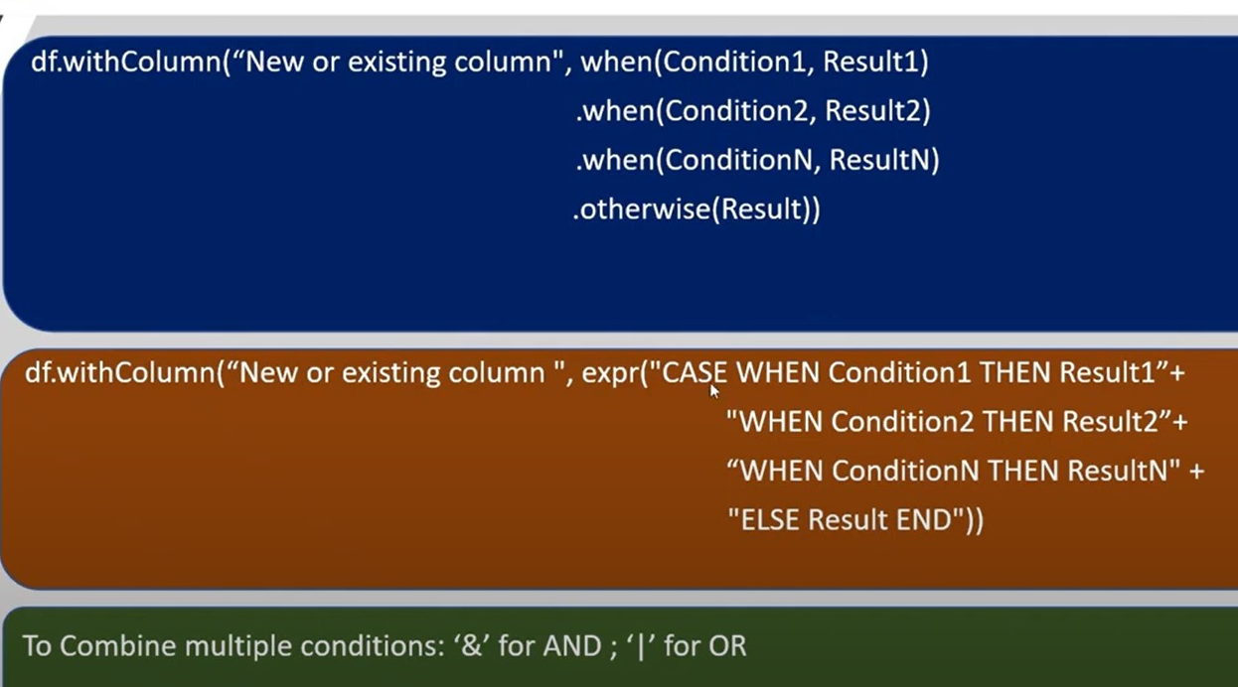

Slide 44
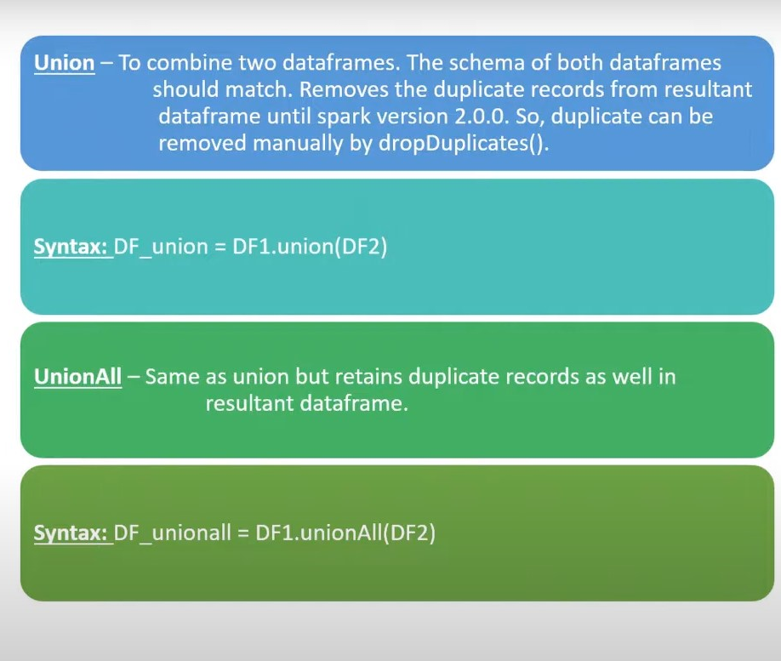
Union / Union All

Slide 45
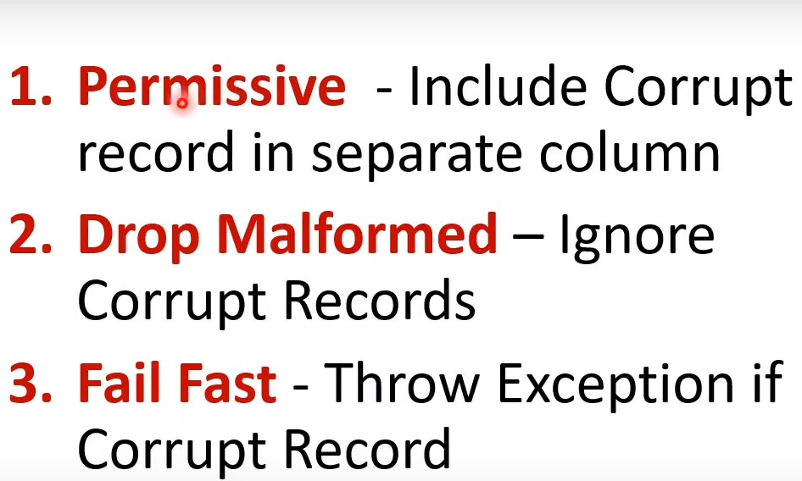
Handling Anomalies

Slide 46
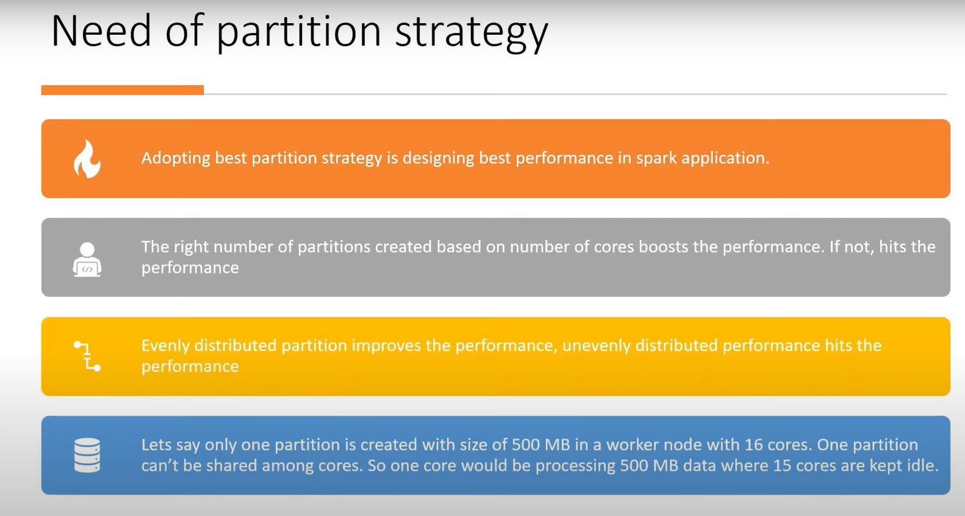

Slide 47
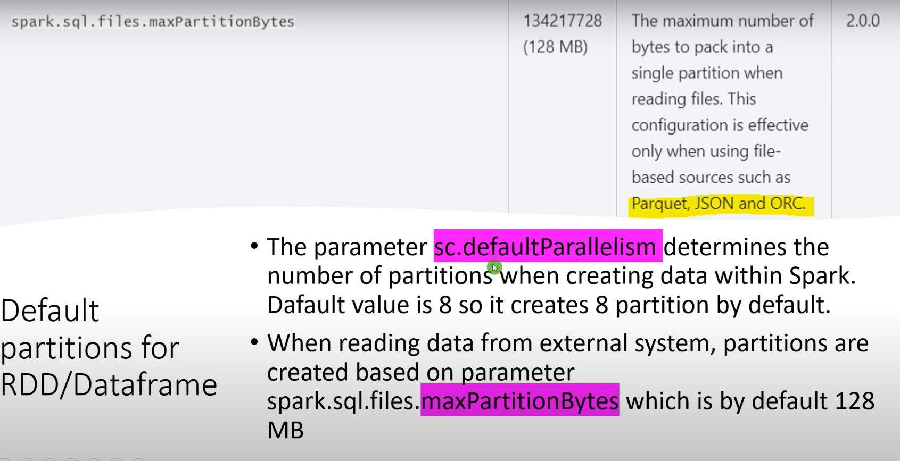

Slide 48
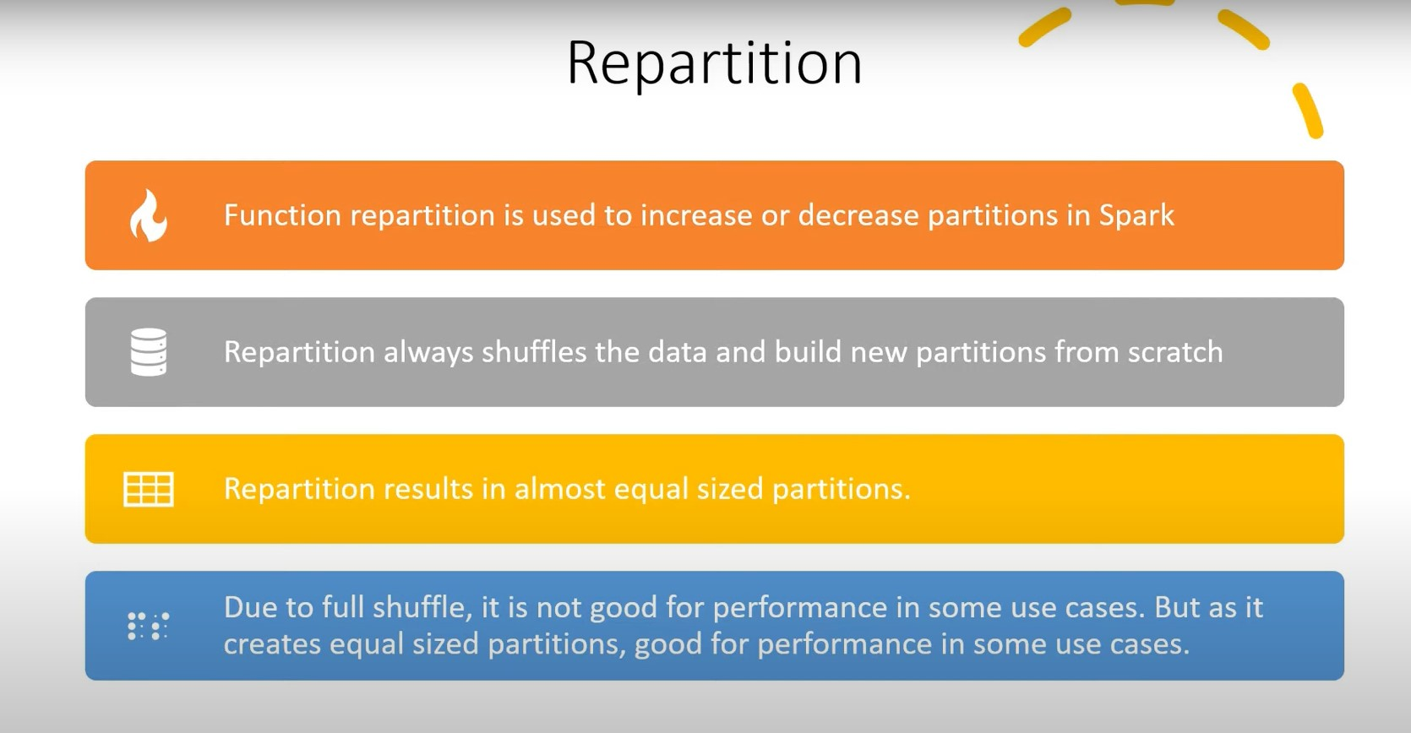

Slide 49
Cache vs persist
Cache → Programming mechanism to store the data in memory
Persist → Store the data either in memory / disk or both across the worker nodes

Slide 50
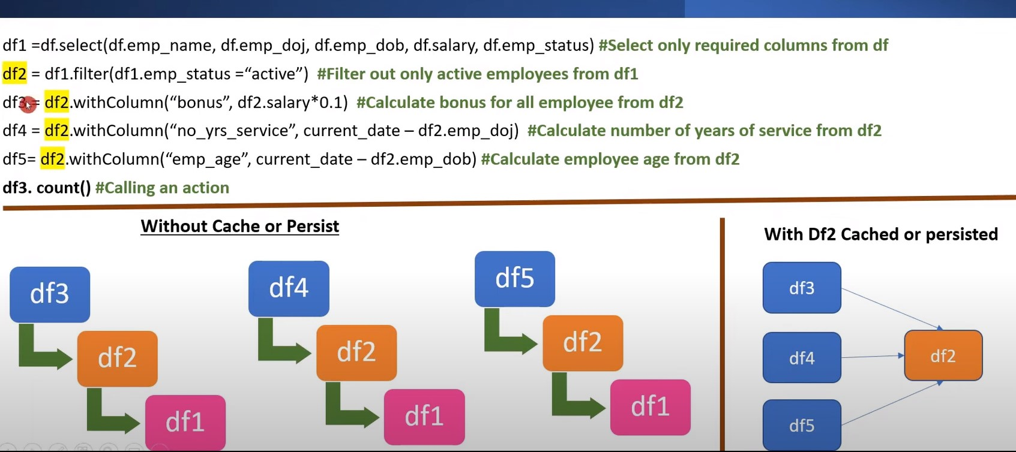

Slide 51
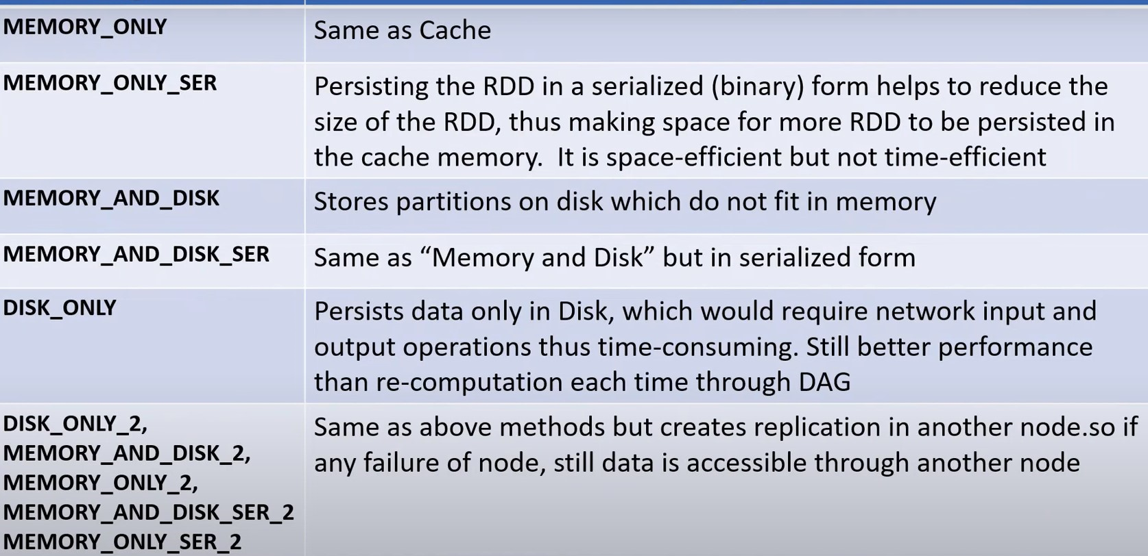

Slide 52
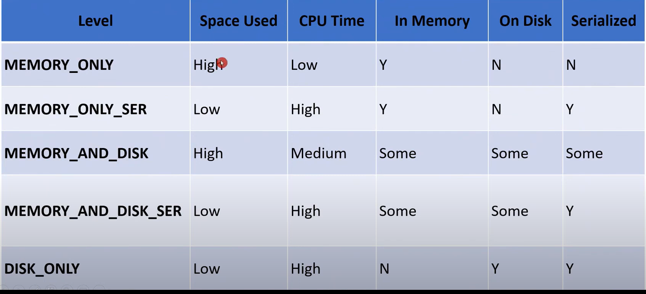

Slide 53
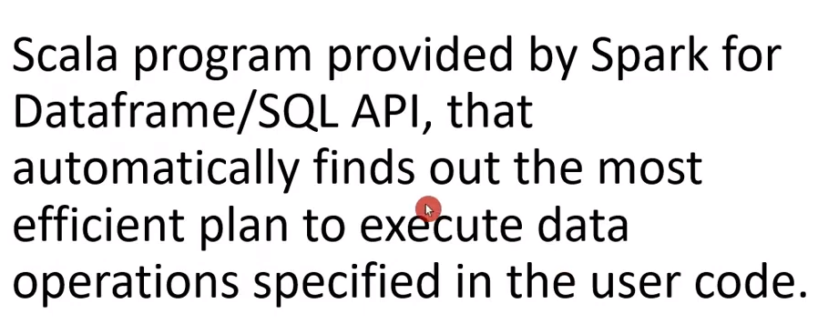
Catalyst Optimizer

Slide 54
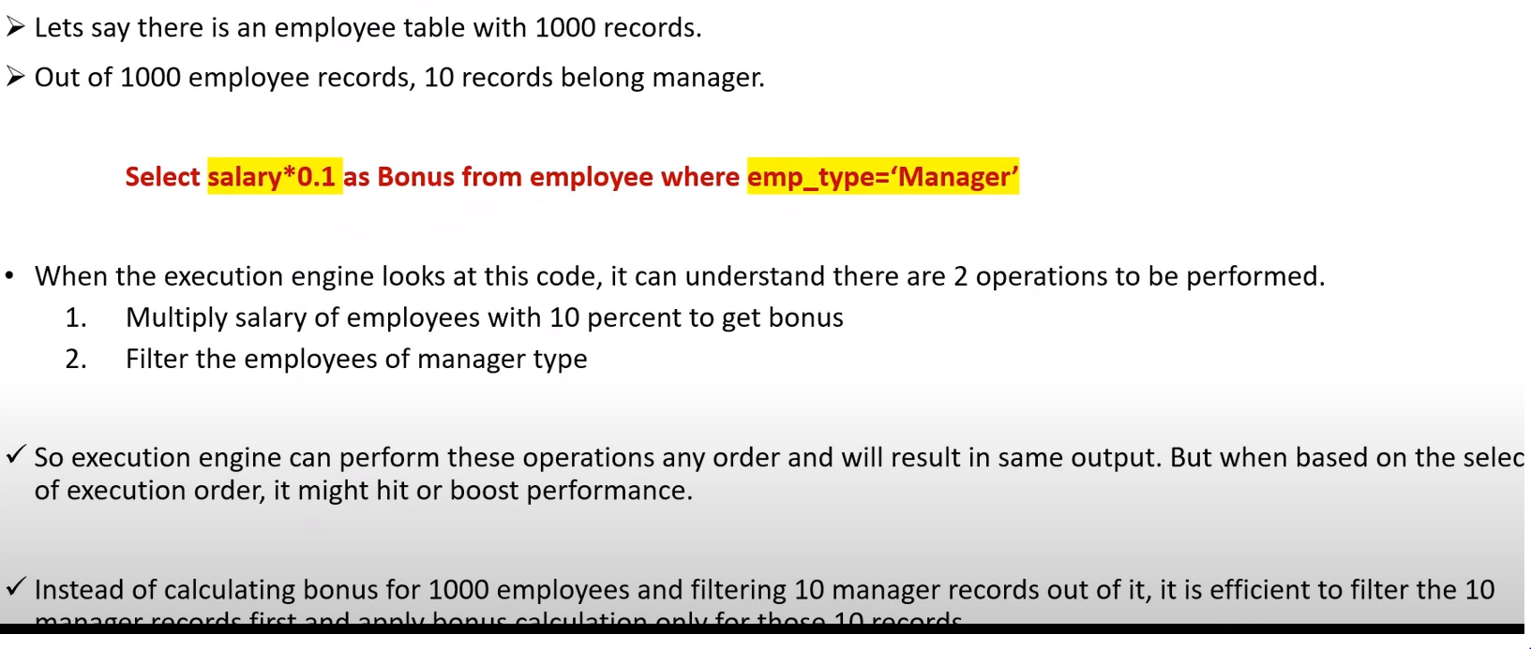

Slide 55
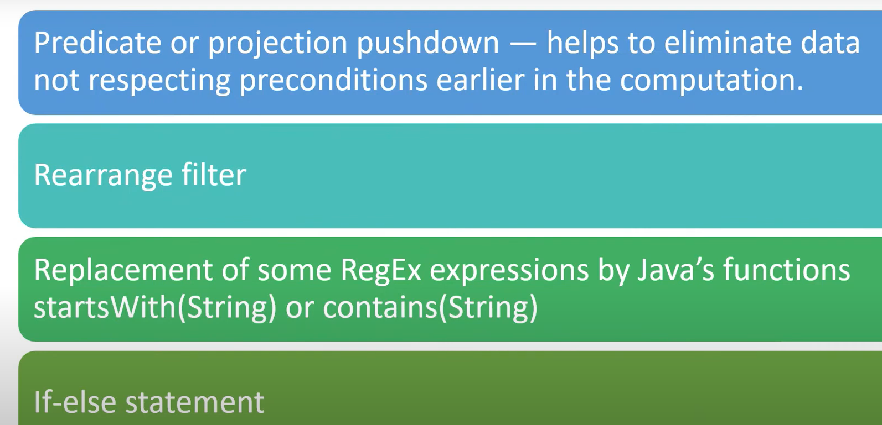
Scope for Optimization

Slide 56
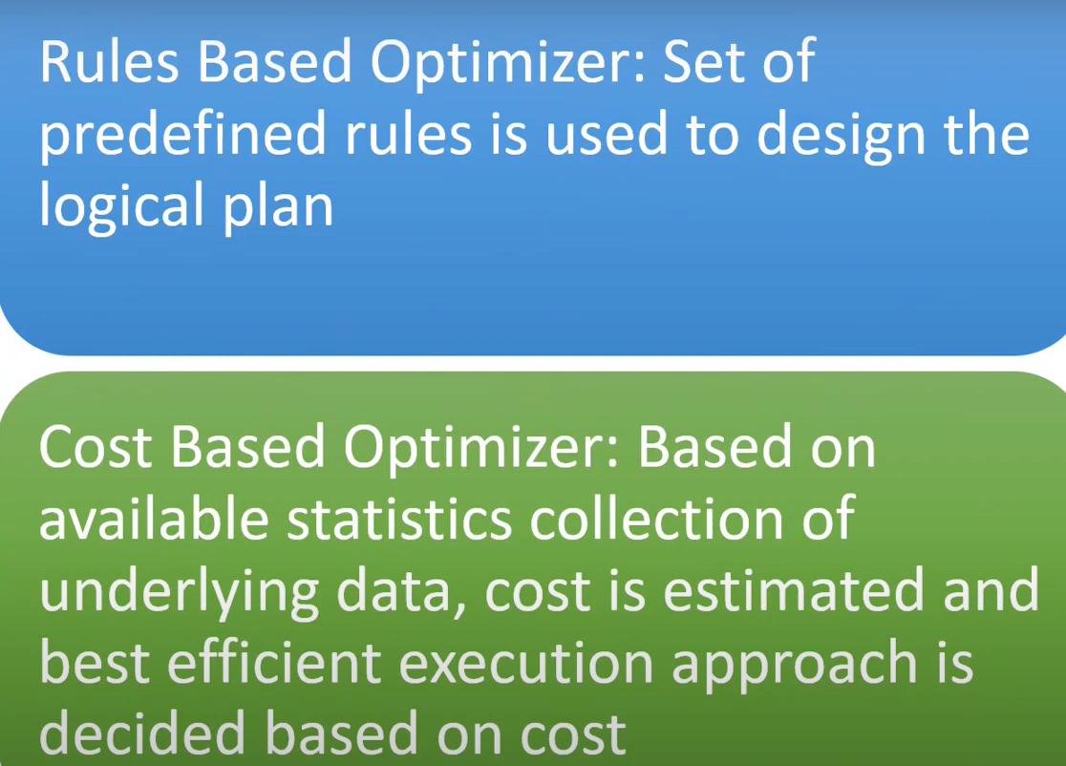
CBO or RBO

Slide 57
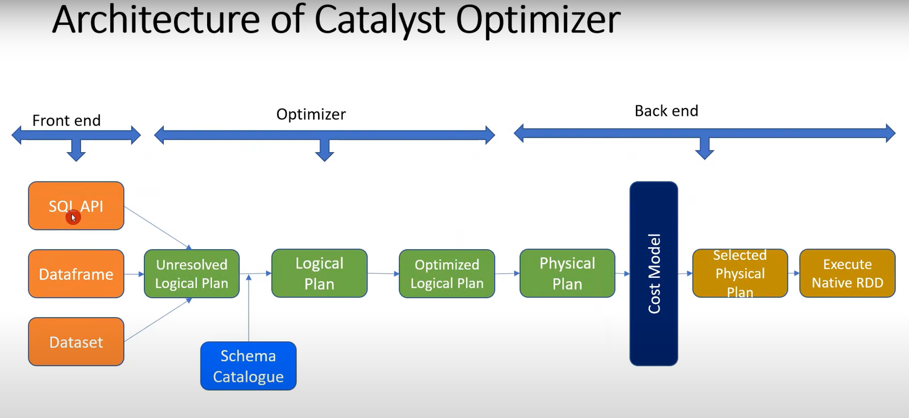

Slide 58
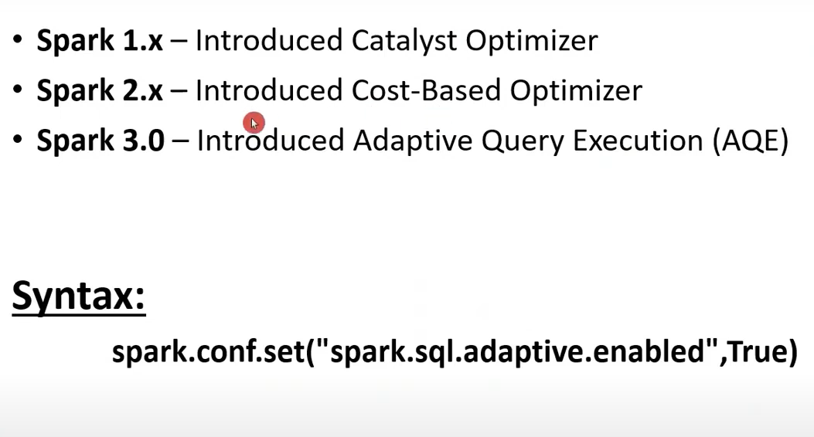

Slide 59
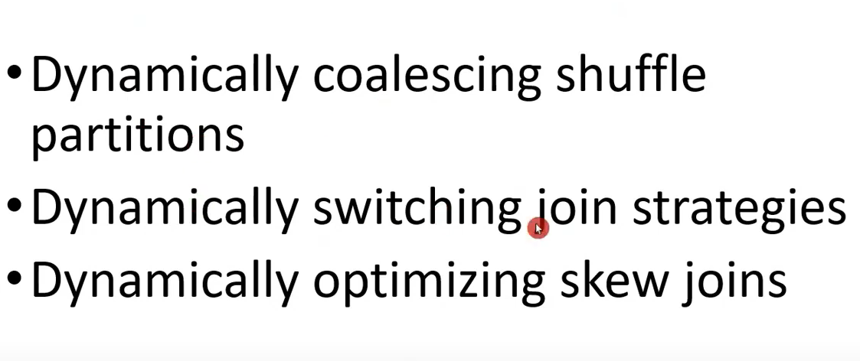

Slide 60
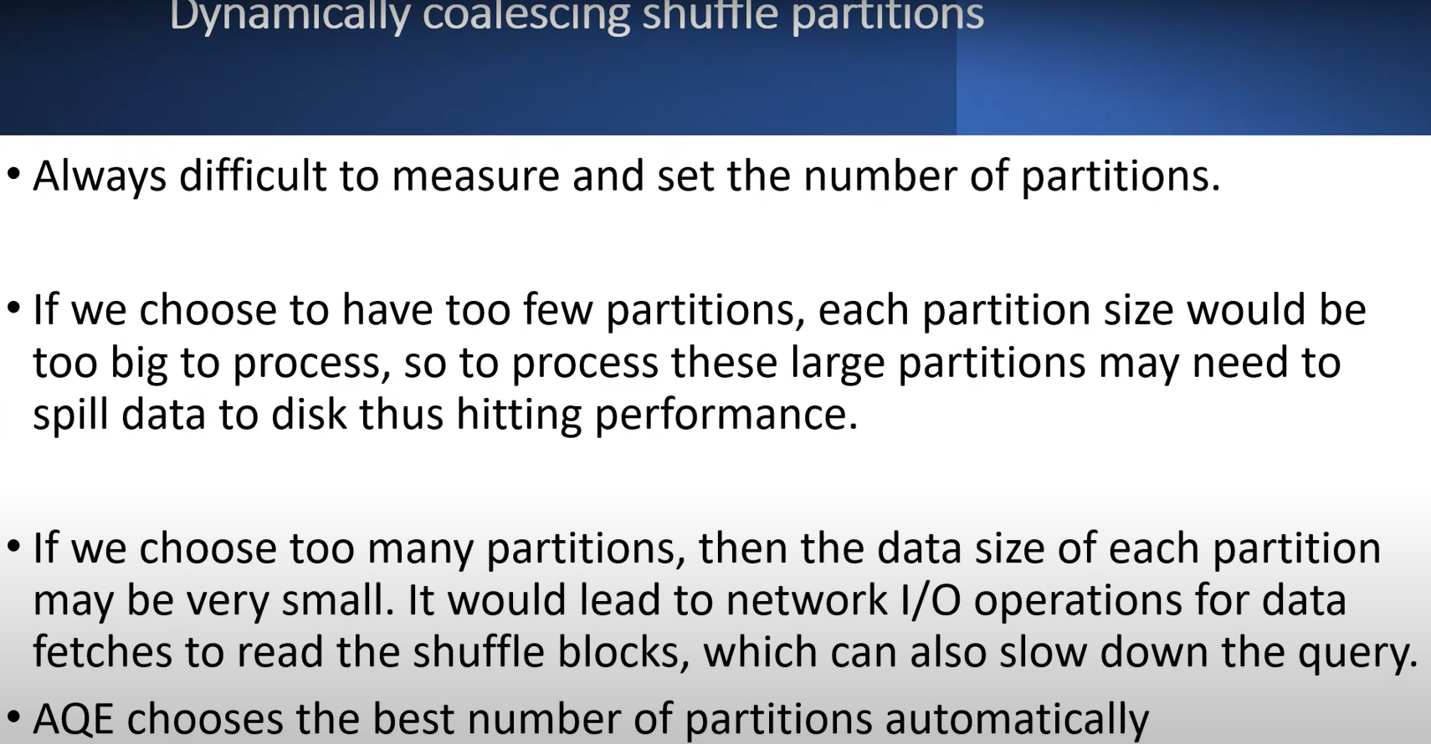

Slide 61
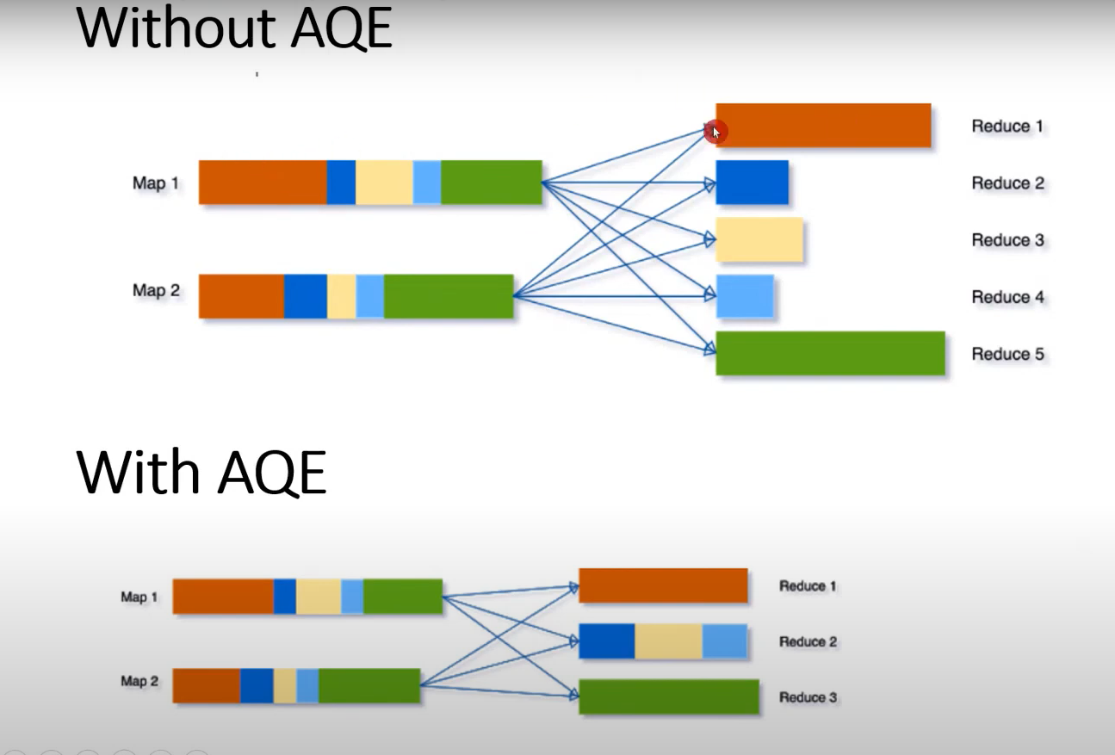

Slide 62
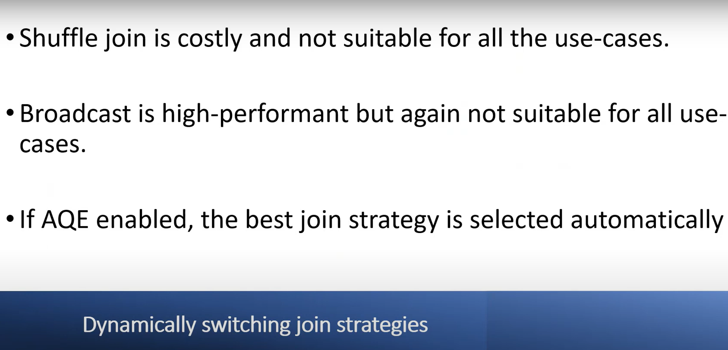

Slide 63
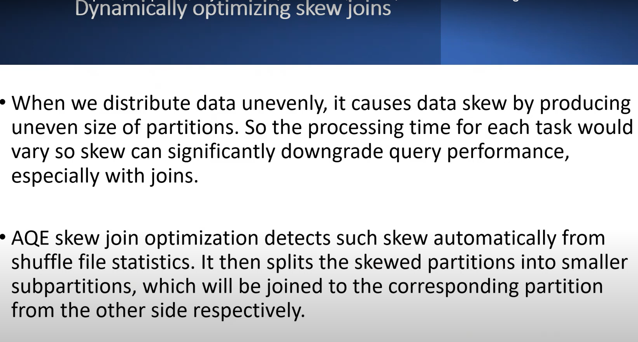

Slide 64
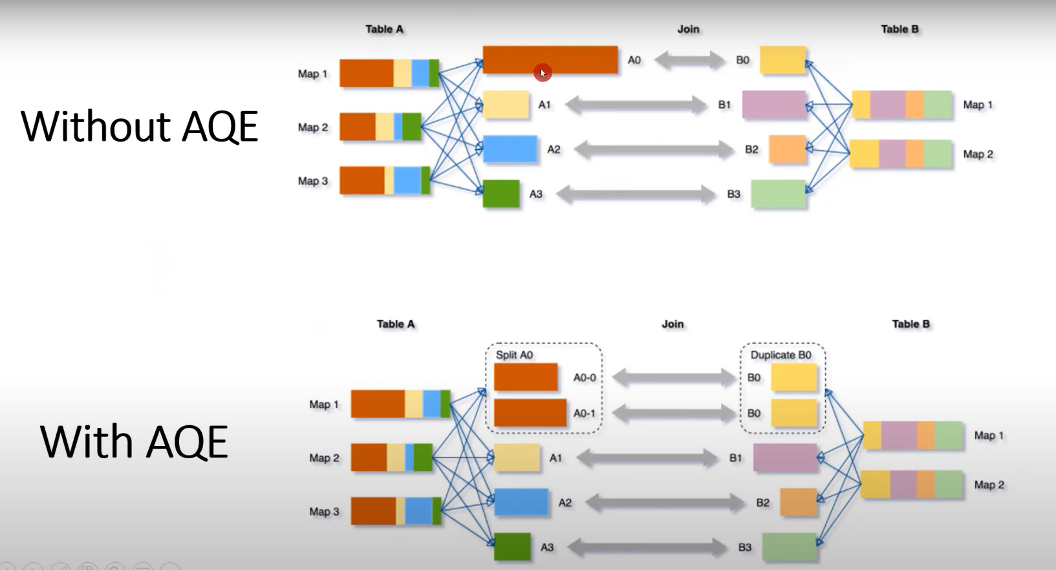

Slide 65
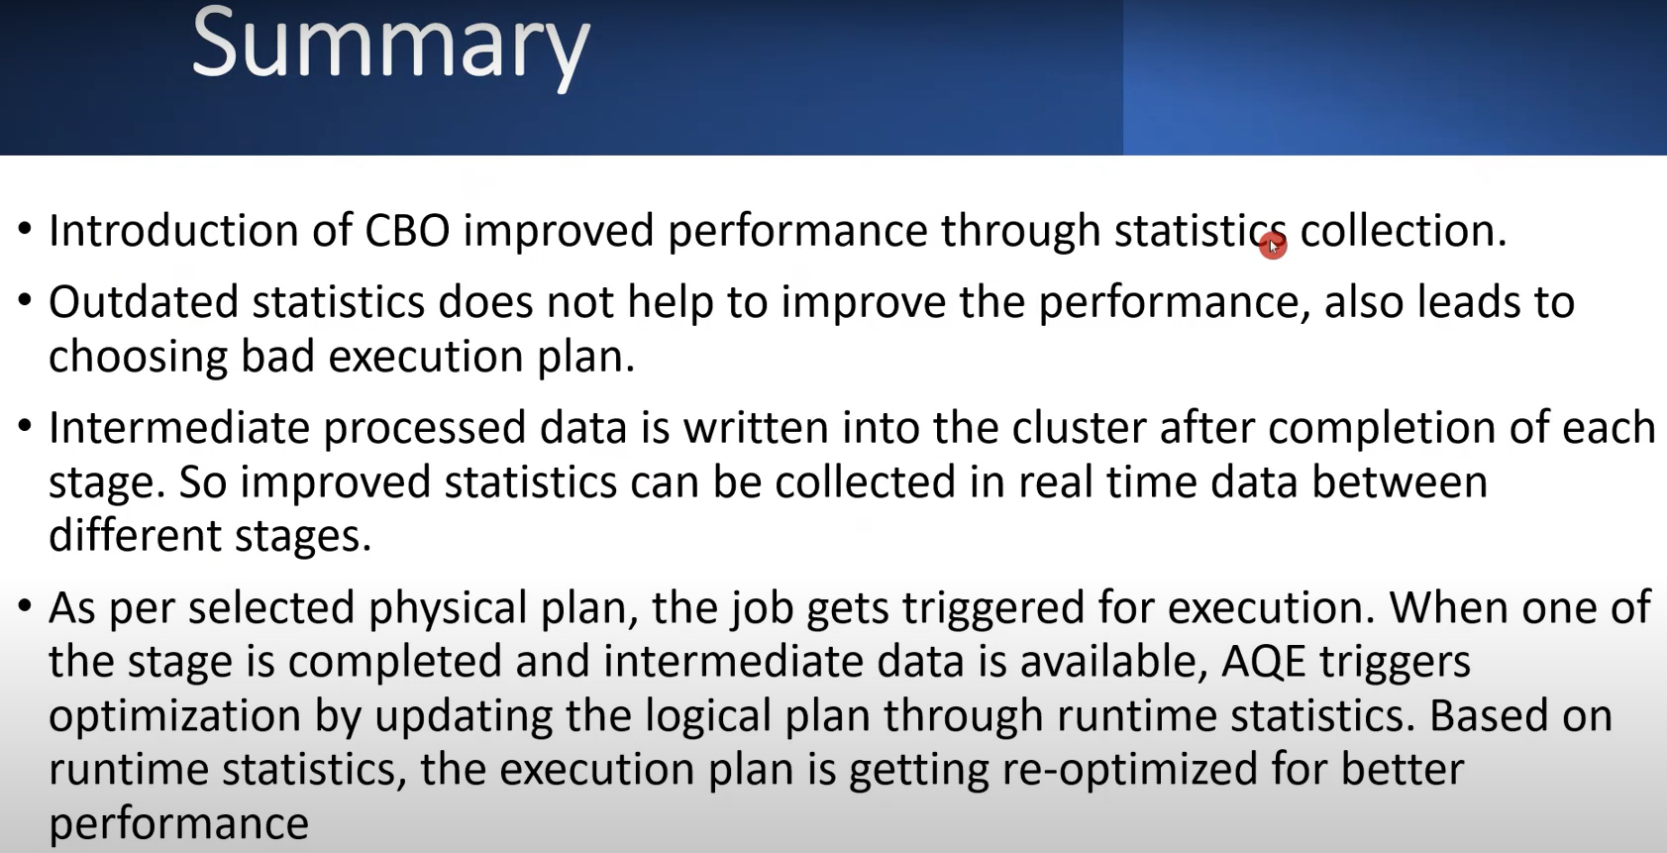

Slide 66
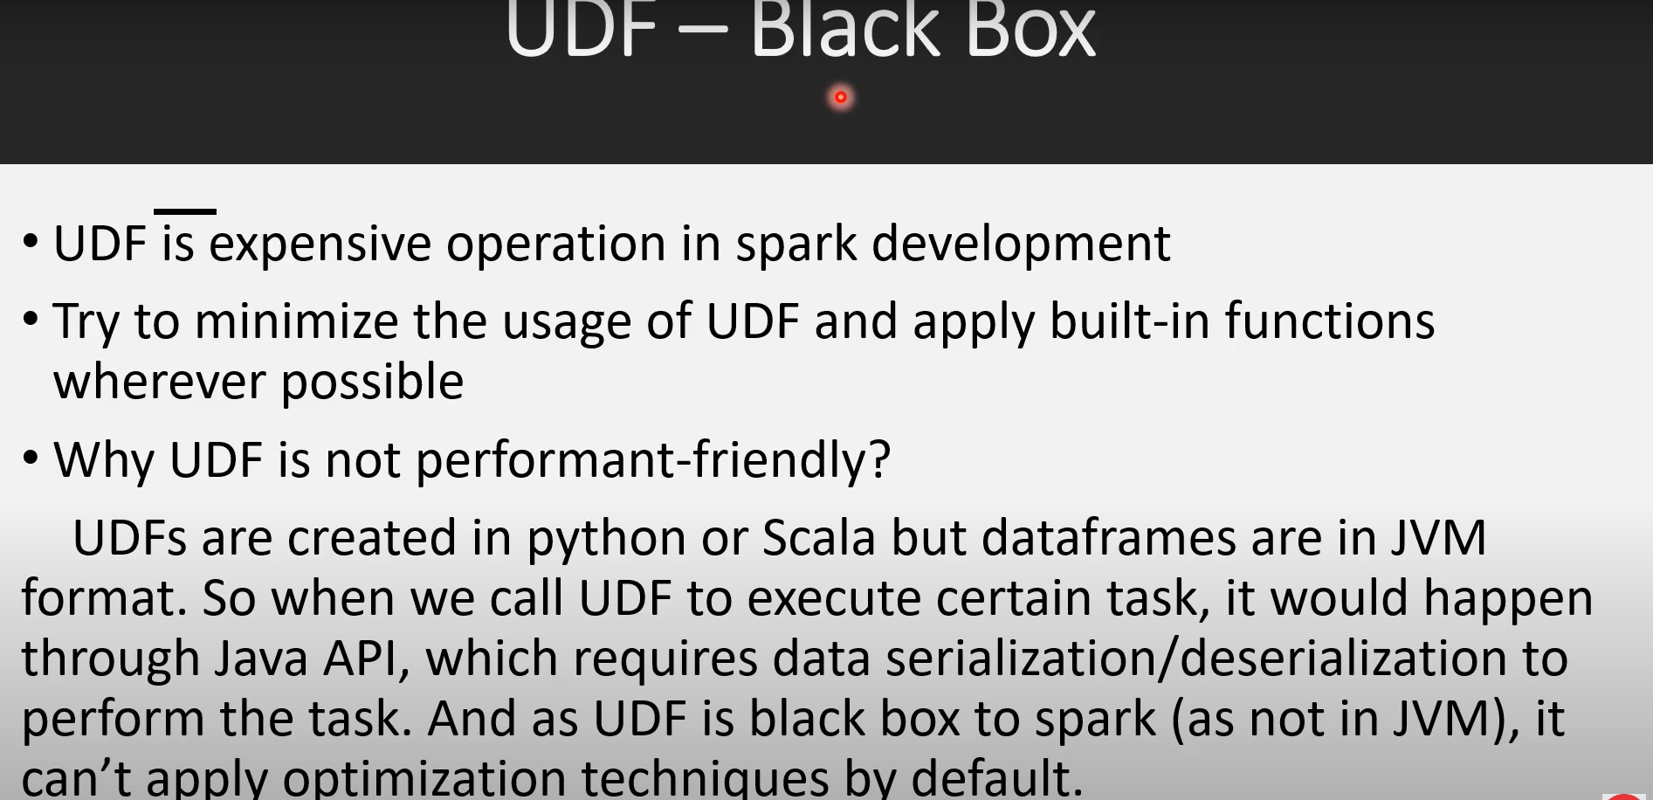

Slide 67
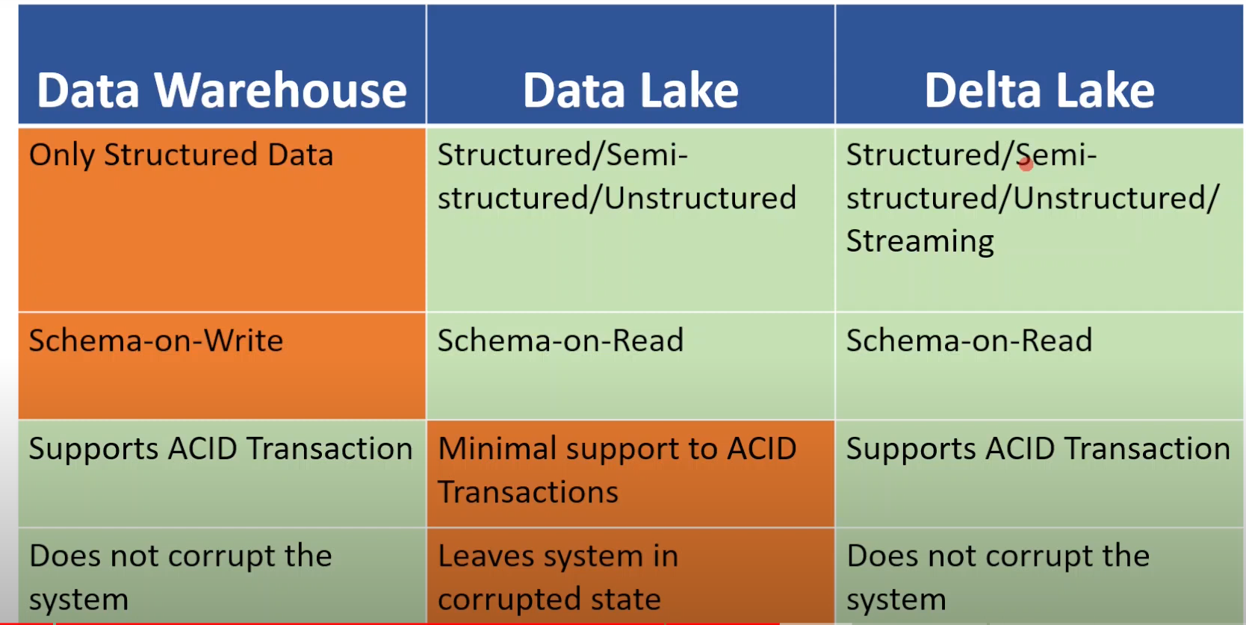

Slide 68
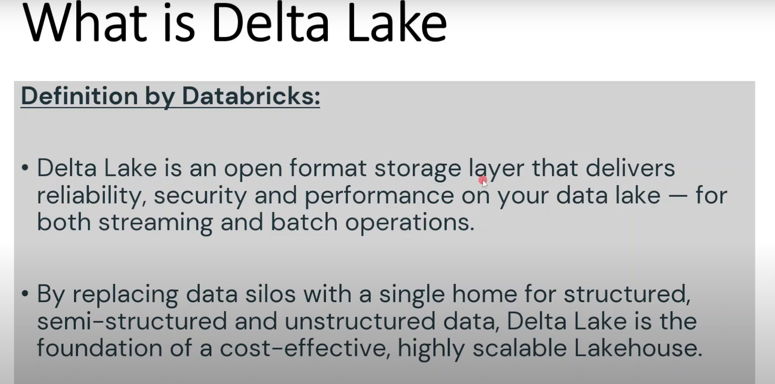

Slide 69


Slide 70


